Slide 1
Complex permittivity of water at room temperature
Jan 14th 2019
Yutong Zhao

Slide 2
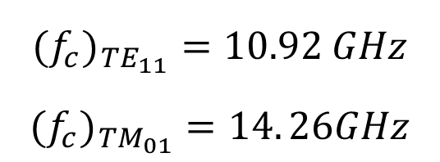
Resonant method: Yao’s 1D cavity
Non-Resonant method: rectangular waveguide
Empty
RO5880
1.40mm RO-5880 material
Empty
1.34mm RO-5880 material
RO-5880
Re
Im
Cutoff frequencies
$$({f_{c})}_{TE_{11}}=10.92 GHz$$
$$({f_{c})}_{TM_{01}}=14. 26GHz$$
The shift may caused by the existence of TM₀₁ mode
More noisy and not accurate than resonant method

Slide 3
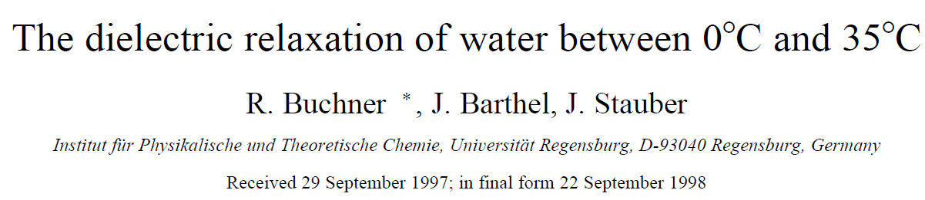
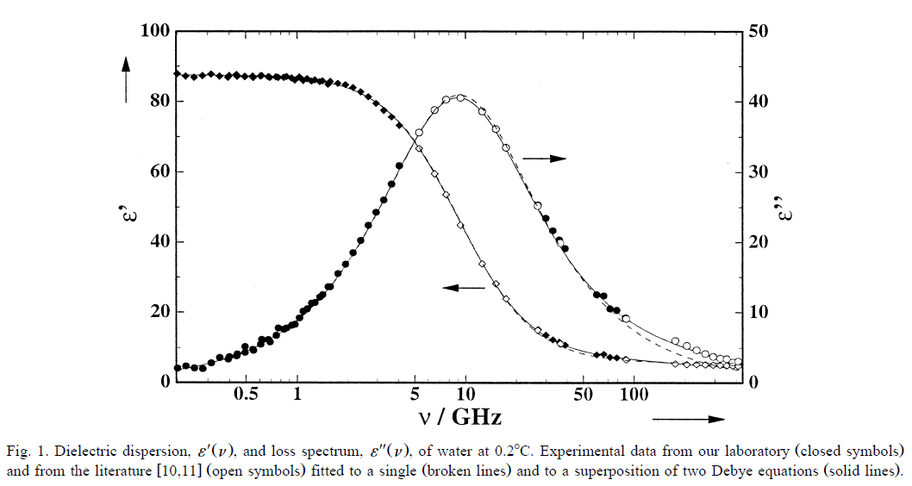

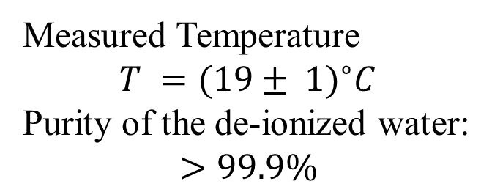
Measured Temperature
$$T =(19± {1)}^{∘}C$$
Purity of the de-ionized water:
$$>99.9\%$$
Debye model of water
at different temperatures
Debye model of water
according to our lab
$${20}^{∘}C±5^{∘}C$$

Slide 4
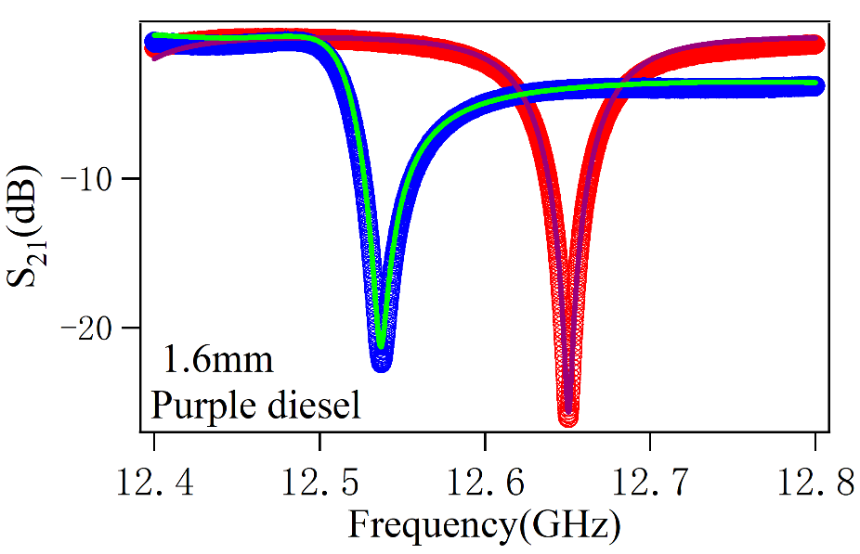
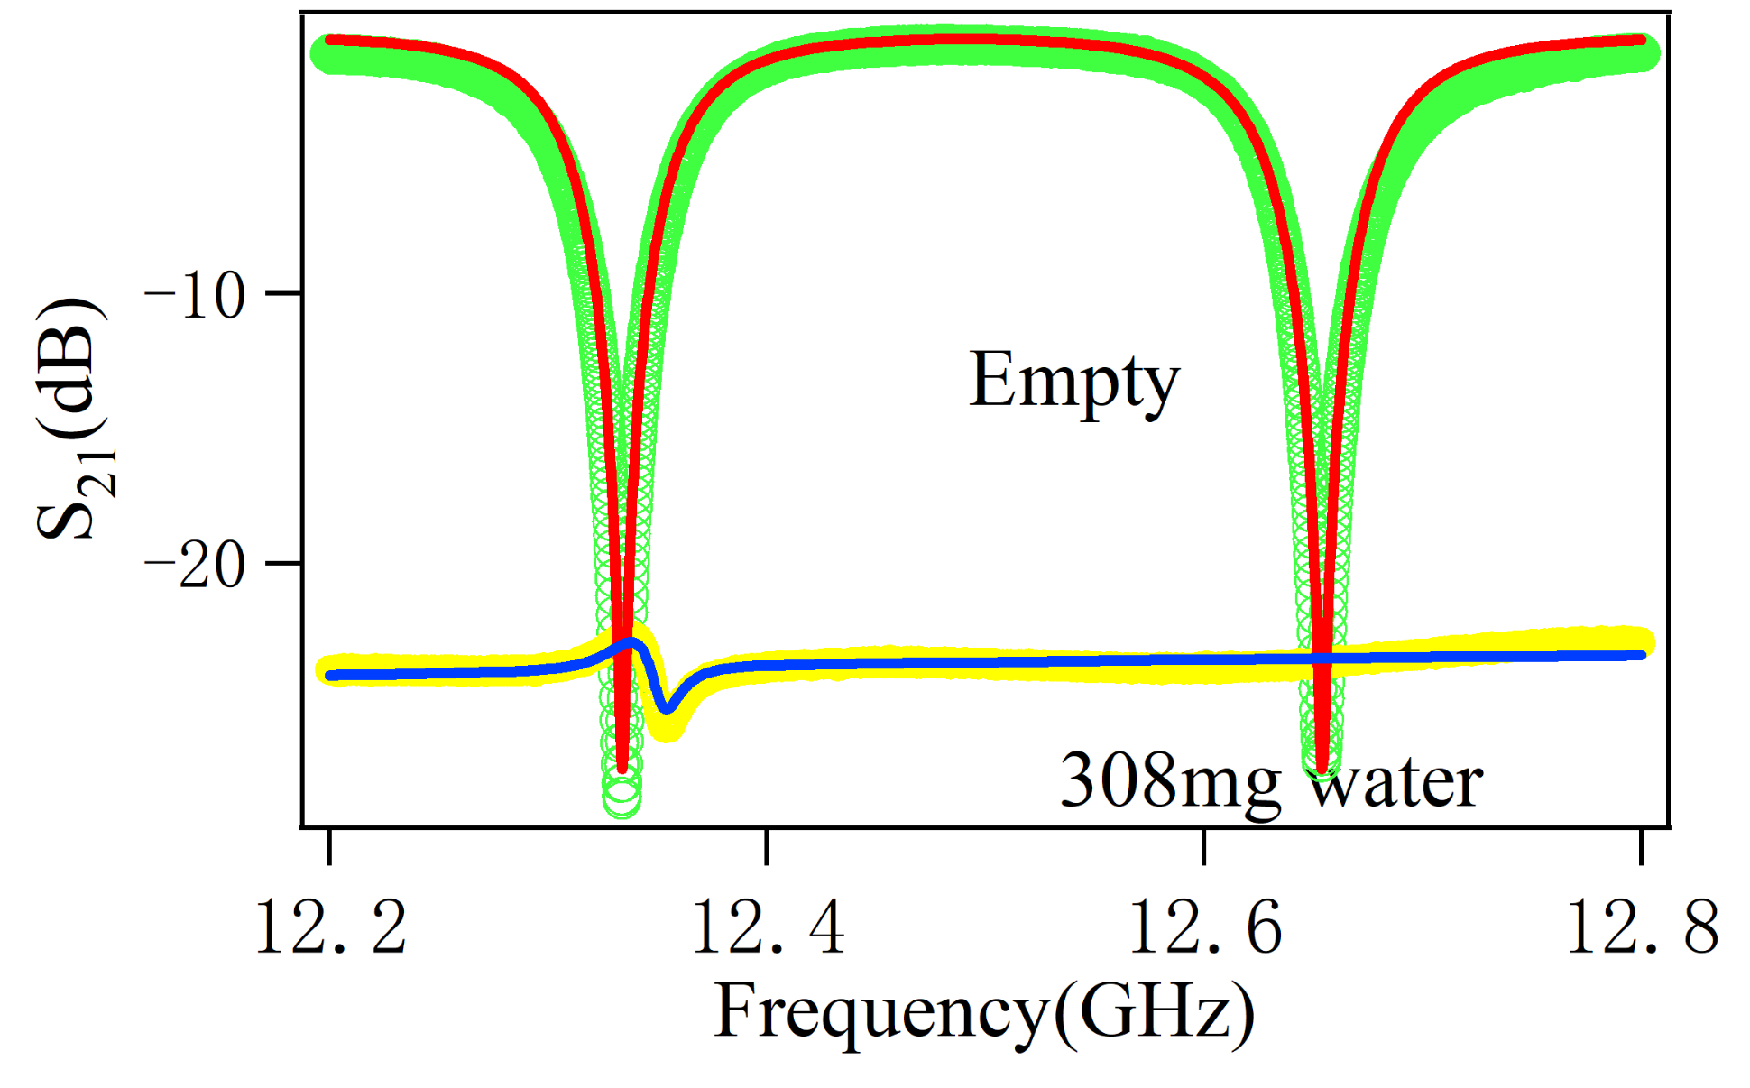
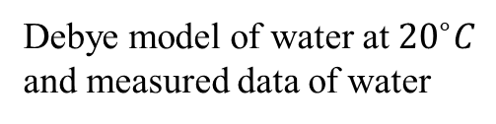
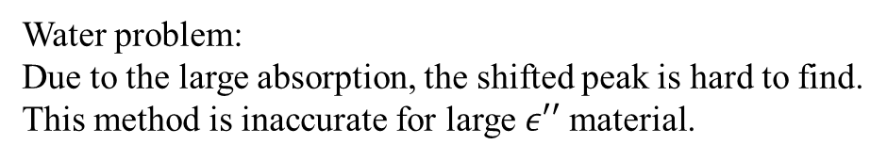
Resonant method
Debye model of water at ${20}^{∘}C$
and measured data of water
Water problem:
Due to the large absorption, the shifted peak is hard to find.
This method is inaccurate for large $ε′′$ material.
Non-Resonant method
Broadband measurement can determine the dielectric constant of water.

Slide 5


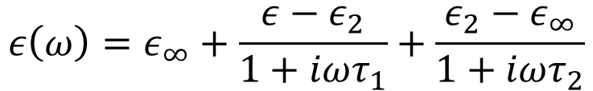
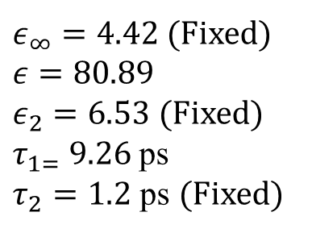
8 – 12GHz
Debye relaxation for water [1]:
X band: 1.450 mL and 1.153 mL
$$ε\left(ω\right)=ε_{∞}+\frac{ε−ε_{2}}{1+iωτ_{1}}+\frac{ε_{2}−ε_{∞}}{1+iωτ_{2}}$$
$ε_{∞}$, $ε$, $ε_{2}$, $τ_{1}$, $τ_{2}$--- fitting parameters
12 – 18GHz
Re
Fitting results
Ku band: 0.485 mL and 0.982 mL
$ε_{∞}=4.42$ (Fixed)
$ε=80.89$
$ε_{2}=6.53$ (Fixed)
$τ_{1=} 9.26$ ps
$τ_{2}=1.2$ ps (Fixed)
Im
[1]
Fixed at ${20}^{∘}C$

Slide 6
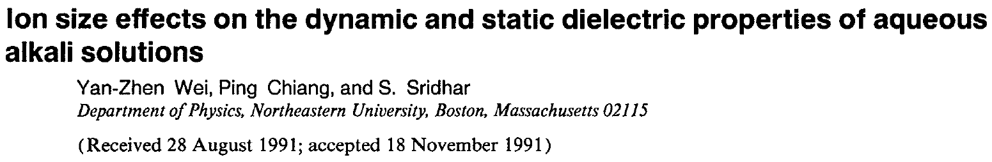
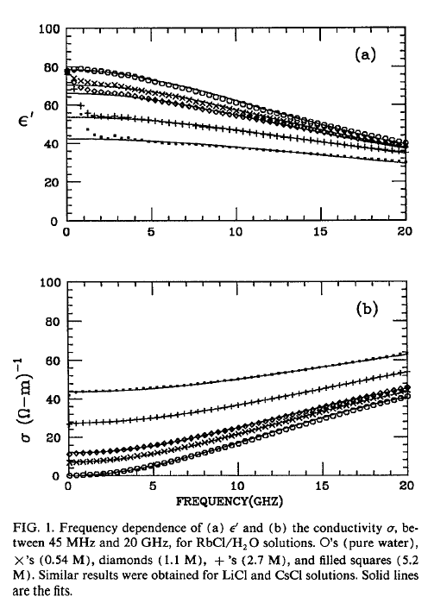
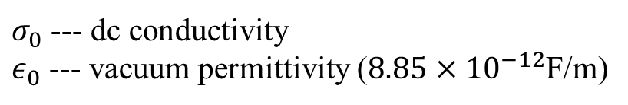
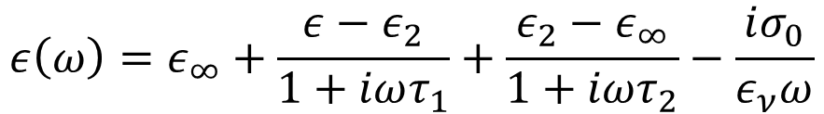
Debye relaxation model for water solutions[2]:
$$ε\left(ω\right)=ε_{∞}+\frac{ε−ε_{2}}{1+iωτ_{1}}+\frac{ε_{2}−ε_{∞}}{1+iωτ_{2}}−\frac{iσ_{0}}{ε_{ν}ω}$$
$σ_{0}$ --- dc conductivity
$ε_{0}$ --- vacuum permittivity ($8.85×{10}^{−12}$F/m)
[2]

